Slide 1

AI FOR GOOD HACKATHON SUBMISSION
The Price of "New"
A 30-second generative film exposing the hidden environmental cost of fast fashion.

Slide 2
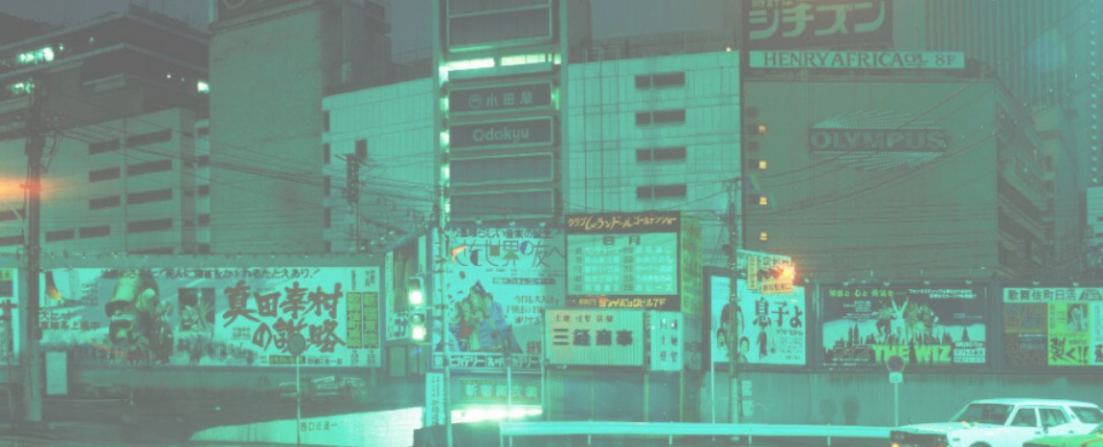

The Prototype
Working 30-second short film generated via ComfyUI.

Slide 3
PROBLEM DEFINITION
The true cost of the fashion industry.
10%
92M
2,700
Global carbon emissions.
Tons of annual textile waste.
Liters of water per shirt.

Slide 4
SDG Alignment
Addressing systemic issues across multiple goals.
13
Climate Action (Primary)
Directly challenging the emission-heavy production cycle.
12
08
15
Responsible Consumption
Decent Work
Life on Land
Combating over-purchasing habits.
Highlighting hidden human costs.
Addressing physical textile waste.

Slide 5
Defining the Viewer
Target Audience
Current Belief
Young, trend-conscious consumers.
"Buying new is cheap, harmless, and necessary to stay relevant."
Frequent buyers of fast fashion.
Social media scrollers.
*Film intentionally excludes established minimalists.

Slide 6

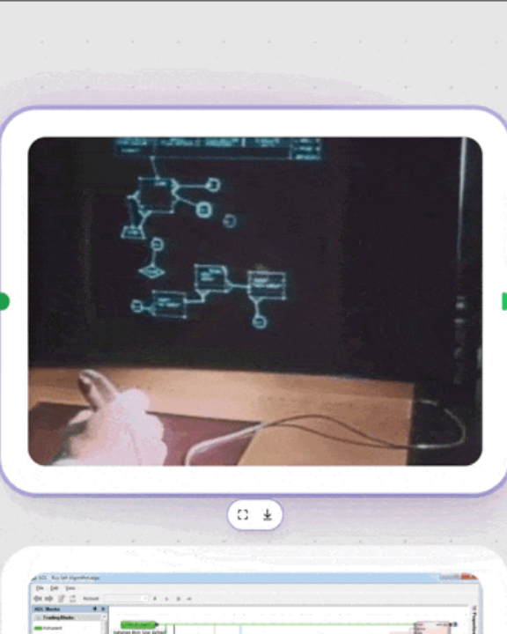
TECHNICAL WORKFLOW
Node-based Stable Diffusion
ComfyUI Pipeline: Full JSON workflow submitted.
Shot List: 8 distinct generated sequences.
Visual Arc: Transitioning from retail glamour to landfill reality.

Slide 7

Why this format works.
Visual Shock
Format Alignment
Emotional Anchor
Juxtaposes retail beauty with environmental destruction.
Designed to disrupt short-form social media scrolling.
Making abstract climate data feel immediate and personal.

Slide 8

Ethical Reflection
The Risk
Generated climate imagery is powerful, creating a risk of misleading viewers into believing synthetic events are real documentaries.
The Mitigation
Maintaining a highly stylized visual aesthetic and providing clear, upfront disclosure of AI generation.

Slide 9
Wear it again.
Buy less. Choose well. Make it last.

Slide 10



Image Sources
https://images.stockcake.com/public/b/f/d/bfd6ca91-bf2f-4bfe-ae09-ec976fae15ca_medium/civilization-s-rusted-remains-stockcake.jpg
Source: stockcake.com
https://aestheticamagazine.com/wp-content/uploads/2022/08/007_Girard_90349B.jpg
Source: aestheticamagazine.com
https://substackcdn.com/image/fetch/$s_!K_Gu!,f_auto,q_auto:good,fl_progressive:steep/https%3A%2F%2Fsubstack-post-media.s3.amazonaws.com%2Fpublic%2Fimages%2F2e06388b-269e-42d2-ac87-97fecc3c9323_800x443.gif
Source: fuser.studio

